Slide 1
Session 3 - Servlet

Slide 2
Agenda
What servlets are all about
Advantages of servlets
What JSP is all about
Free servlet and JSP engines
Compiling and invoking servlets
Servlet structure
A few basic servlets
Servlet lifecycle
Initializing servlets
Debugging servlets

Slide 3
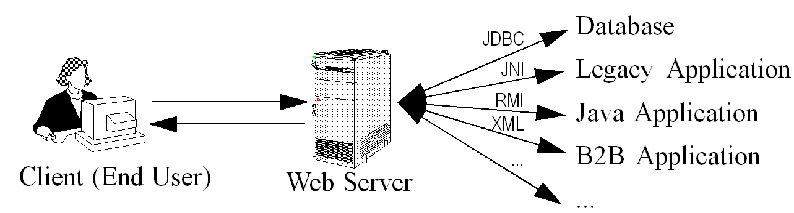
A Servlet’s Job
Read explicit data sent by client (form data)
Read implicit data sent by client
(request headers)
Generate the results
Send the explicit data back to client (HTML)
Send the implicit data to client
(status codes and response headers)

Slide 4
Why Build Web Pages Dynamically?
The Web page is based on data submitted by the user
  E.g., results page from search engines and order-confirmation pages at on-line stores
The Web page is derived from data that changes frequently
  E.g., a weather report or news headlines page
The Web page uses information from databases or other server-side sources
  E.g., an e-commerce site could use a servlet to build a Web page that lists the current price and availability of each item that is for sale.

Slide 5
The Advantages of Servlets Over “Traditional” CGI
Efficient
  Threads instead of OS processes, one servlet copy, persistence
Convenient
  Lots of high-level utilities
Powerful
  Sharing data, pooling, persistence
Portable
  Run on virtually all operating systems and servers
Secure
  No shell escapes, no buffer overflows
Inexpensive
  There are plenty of free and low-cost servers.

Slide 6
Extending the Power of Servlets: JavaServer Pages (JSP)
Idea:
  Use regular HTML for most of page
  Mark dynamic content with special tags
  Details in second half of course
<!DOCTYPE HTML PUBLIC "-//W3C//DTD HTML 4.0 Transitional//EN">
<HTML>
<HEAD><TITLE>Welcome to Our Store</TITLE></HEAD>
<BODY>
<H1>Welcome to Our Store</H1>
<SMALL>Welcome,
<!-- User name is "New User" for first-time visitors -->
<%= coreservlets.Utils.getUserNameFromCookie(request) %>
To access your account settings, click
<A HREF="Account-Settings.html">here.</A></SMALL>
<P>
Regular HTML for rest of on-line store’s Web page
</BODY></HTML>

Slide 7
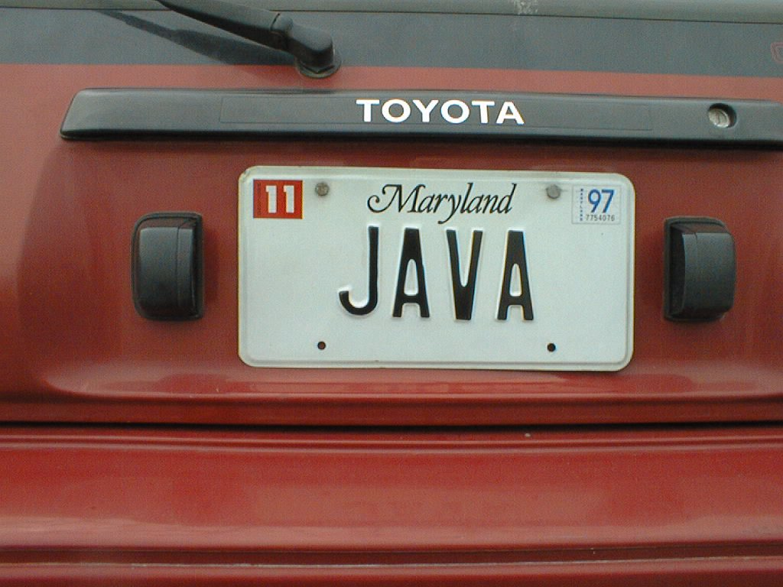
Server-Side Java is
Driving the Web
Get
on board or
get
out
of
the way

Slide 8
Free Servlet and JSP Engines
Apache Tomcat
  http://jakarta.apache.org/tomcat/
  See http://www.moreservlets.com/Using-Tomcat-4.html
Allaire/Macromedia JRun
  http://www.macromedia.com/software/jrun/
New Atlanta ServletExec
  http://www.servletexec.com/
Gefion Software LiteWebServer
  http://www.gefionsoftware.com/LiteWebServer/
Caucho's Resin
  http://www.caucho.com/
Notes:
I have Tomcat, JRun, and ServletTM Exec installed on my desktop. I routinely test with all three.
Note that these are all free only for development purposes. Except with Tomcat, you have to pay to use them as deployment servers.

Slide 9
Compiling and Invoking Servlets
Set your CLASSPATH
  Servlet JAR file (e.g., install_dir/common/lib/servlet.jar).
  Top of your package hierarchy
Put your servlet classes in proper location
  Locations vary from server to server. E.g.,
    tomcat_install_dir/webapps/ROOT/WEB-INF/classes
    See http://www.moreservlets.com/Using-Tomcat-4.html
    jrun_install_dir/servers/default/default-app/WEB-INF/classes
Invoke your servlets
  http://host/servlet/ServletName
  Custom URL-to-servlet mapping (via web.xml)
Notes:
The server already knows where the classes are. These settings are so that the developer can compile code.
Although package use with servlets is the same as with “regular” Java programming, forgetting to include the top of your package hierarchy in the CLASSPATH is the single most common mistake by beginners
In real-life applications, it is common to group servlets and JSP pages into “Web application”. If you do this, the URL to invoke a servlet is http://host/webAppPrefix/servlet/ServletName. It is also common to use the servlet-mapping and url-pattern elements of web.xml to give a custom URL to the servlet so that you don’t use the “servlet” part of the URL at all.

Slide 10
Simple Servlet Template
import java.io.*;
import javax.servlet.*;
import javax.servlet.http.*;
public class ServletTemplate extends HttpServlet {
public void doGet(HttpServletRequest request,
HttpServletResponse response)
throws ServletException, IOException {
// Use "request" to read incoming HTTP headers
// (e.g. cookies) and HTML form data (query data)
// Use "response" to specify the HTTP response status
// code and headers (e.g. the content type, cookies).
PrintWriter out = response.getWriter();
// Use "out" to send content to browser
}
}

Slide 11
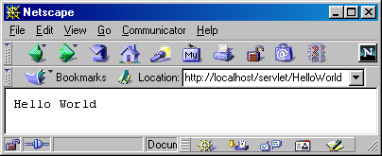
A Simple Servlet That Generates Plain Text
import java.io.*;
import javax.servlet.*;
import javax.servlet.http.*;
public class HelloWorld extends HttpServlet {
public void doGet(HttpServletRequest request,
HttpServletResponse response)
throws ServletException, IOException {
PrintWriter out = response.getWriter();
out.println("Hello World");
}
}

Slide 12
Compiling and Invoking Servlet (Tomcat 4; Class Setup)
Place code in C:\Servlets+JSP.
  R-click on source code at http://archive.coreservlets.com
CLASSPATH already set
Start DOS; type "javac HelloWorld.java"
Place HelloWorld.class in servlet directory
  C:\jakarta-tomcat-4.0\webapps\ROOT\WEB-INF\classes
  Drag files onto shortcut in Servlets+JSP directory
Start server
  Double click startup.bat
Invoke servlet
  http://localhost/servlet/HelloWorld
Notes:
Everything will be simple with NetBean, is version 6.8 now
From now on, Tomcat version 5.0 and later, you must configure web.xml to define mapping name of a servlet

Slide 13
Generating HTML
Set the Content-Type header
  Use response.setContentType
Output HTML
  Be sure to include the DOCTYPE
Use an HTML validation service
  http://validator.w3.org/
  http://www.htmlhelp.com/tools/validator/
  If your servlets are behind a firewall, you can run them, save the HTML output, and use a file upload form to validate.

Slide 14
A Servlet That Generates HTML
public class HelloWWW extends HttpServlet {
public void doGet(HttpServletRequest request,
HttpServletResponse response)
throws ServletException, IOException {
response.setContentType("text/html");
PrintWriter out = response.getWriter();
String docType =
"<!DOCTYPE HTML PUBLIC \"-//W3C//DTD HTML 4.0 " +
"Transitional//EN\">\n";
out.println(docType +
"<HTML>\n" +
"<HEAD><TITLE>Hello WWW</TITLE></HEAD>\n" +
"<BODY>\n" +
"<H1>Hello WWW</H1>\n" +
"</BODY></HTML>");
}
}

Slide 15
Packaging Servlets
Move the files to a subdirectory that matches the intended package name
  For example, I’ll use the coreservlets package for most of the rest of the servlets in this course. So, the class files need to go in a subdirectory called coreservlets.
Insert a package statement in the class file
  E.g., top of HelloWWW2.java:
  package coreservlets;
Set CLASSPATH to top-level directory
  E.g., C:\Servlets+JSP.
Include package name in URL
  http://localhost/servlet/coreservlets.HelloWWW2
Notes:
Will be practiced in lab session

Slide 16
Some Simple HTML-Building Utilities
public class ServletUtilities {
public static final String DOCTYPE =
"<!DOCTYPE HTML PUBLIC \"-//W3C//DTD HTML 4.0 " +
"Transitional//EN\">";
public static String headWithTitle(String title) {
return(DOCTYPE + "\n" +
"<HTML>\n" +
"<HEAD><TITLE>" + title + "</TITLE></HEAD>\n");
}
...
}
Don’t go overboard
  Complete HTML generation packages
  usually work poorly
  The JSP framework is a better solution

Slide 17
HelloWWW with ServletUtilities
package coreservlets;
import java.io.*;
import javax.servlet.*;
import javax.servlet.http.*;
public class HelloWWW3 extends HttpServlet {
public void doGet(HttpServletRequest request,
HttpServletResponse response)
throws ServletException, IOException {
response.setContentType("text/html");
PrintWriter out = response.getWriter();
out.println(ServletUtilities.headWithTitle("Hello WWW") +
"<BODY>\n" +
"<H1>Hello WWW</H1>\n" +
"</BODY></HTML>");
}
}

Slide 18
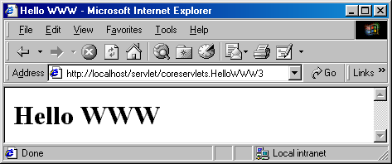
HelloWWW Result

Slide 19
The Servlet Life Cycle
init
  Executed once when the servlet is first loaded.
  Not called for each request.
service
  Called in a new thread by server for each request. Dispatches to doGet, doPost, etc.
  Do not override this method!
doGet, doPost, doXxx
  Handles GET, POST, etc. requests.
  Override these to provide desired behavior.
destroy
  Called when server deletes servlet instance.
  Not called after each request.
Notes:
Draw a simple figure to illustrate the idea

Slide 20
Why You Should
Not Override service
You can add support for other services later by adding doPut, doTrace, etc.
You can add support for modification dates by adding a getLastModified method
The service method gives you automatic support for:
  HEAD requests
  OPTIONS requests
  TRACE requests
Alternative: have doPost call doGet

Slide 21
Initializing Servlets
Common in real-life servlets
  E.g., initializing database connection pools.
Use ServletConfig.getInitParameter to read initialization parameters
Set init parameters in web.xml (ver 2.2/2.3)
  …/WEB-INF/web.xml
  Many servers have custom interfaces to create web.xml
It is common to use init even when
you don’t read init parameters
  See modification date example in
  Core Servlets and JavaServer Pages Chapter 2
Notes:
Three potential people who could customize things:
Developer Using Java technology
Deployer
End user
It is the deployer who would set initialization parameters

Slide 22
Debugging Servlets
Use print statements; run server on desktop
Use Apache Log4J
Integrated debugger in IDE
Look at the HTML source
Return error pages to the client
  Plan ahead for missing or malformed data
Use the log file
  log("message") or log("message", Throwable)
Separate the request and response data .
  Request: see EchoServer at www.coreservlets.com
  Response: see WebClient at www.coreservlets.com
Stop and restart the server
Notes:
Type of debugs.
Intro about FireBug.

Slide 23
Web Applications: A Preview
Learning
  Use default Web application (ROOT on Tomcat)
  Use default URLs (http://…/servlet/ServletName)
  Advantages
    Simpler
    Can test without restarting server or editing web.xml
Deployment
  Use a custom Web application (on Tomcat, a directory in install_dir/webapps with structure similar to ROOT)
  Register custom URLs in WEB-INF/web.xml
  Advantages
    URLs look better
    Advanced features (init params, security, filters, etc.) depend on your using custom URLS
Notes:
From this slide to slide 26, use Netbean instead of this

Slide 24
Making Custom Web Apps
Make a directory whose structure mirrors the structure of the default Web application.
  HTML (and, eventually, JSP) documents go in the top-level directory
  The web.xml file goes in the WEB-INF subdirectory
  Servlets and other classes go either in WEB-INF/classes or a subdirectory of WEB-INF/classes that matches the package name.
  On Tomcat, entire directory goes in install_dir/webapps
Update your CLASSPATH.
  Add webAppDir/WEB-INF/classes to it.

Slide 25
Making Custom Web Apps
Use the directory name in the URL
  All URLs should be of the form http://host/webAppDir/…
Use web.xml to assign custom URLs
  Use the servlet and servlet-mapping elements
  <servlet>
  <servlet-name>Servlet2</servlet-name>
  <servlet-class>
  coreservlets.HelloServlet2
  </servlet-class>
  </servlet>
  <servlet-mapping>
  <servlet-name>Servlet2</servlet-name>
  <url-pattern>/servlet2</url-pattern>
  </servlet-mapping>
Notes:
Everything can be done with NetBean

Slide 26
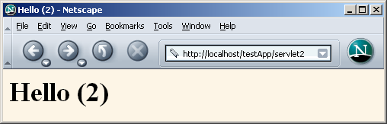
Making Custom Web Apps

Slide 27
Summary
Servlets are efficient, portable, powerful, and widely accepted in industry
Regardless of deployment server, run a free server on your desktop for development
Getting started:
  Set your CLASSPATH
    Servlet JAR file
    Top of your package hierarchy
  Put class files in proper location
    .../WEB-INF/classes
  Use proper URL, usually http://host/servlet/ServletName
Download existing servlet first time
  Start with HelloWWW from www.coreservlets.com

Slide 28
Summary (Continued)
Main servlet code goes in doGet or doPost:
  The HttpServletRequest contains the incoming information
  The HttpServletResponse lets you set outgoing information
    Call setContentType to specify MIME type
    Call getWriter to obtain a Writer pointing to client
One-time setup code goes in init
  Servlet gets initialized and loaded once
  Servlet gets invoked multiple times
  Initialization parameters set in web.xml (covered in detail in More Servlets & JavaServer Pages Chapter 5)

Slide 29
Handling the Client Request: Form Data

Slide 30
Agenda
Why form data is important
Processing form data in traditional CGI
Processing form data in servlets
Reading individual request parameters
Reading all request parameters
Real-life servlets: handling malformed data
Filtering HTML-specific characters

Slide 31
The Role of Form Data
Example URL at online travel agent
  http://host/path?user=Marty+Hall&origin=bwi&dest=lax
  Names come from HTML author;
  values usually come from end user
Parsing form (query) data in traditional CGI
  Read the data one way (QUERY_STRING) for GET requests, another way (standard input) for POST requests
  Chop pairs at ampersands, then separate parameter names (left of the equal signs) from parameter values (right of the equal signs)
  URL decode values (e.g., "%7E" becomes "~")
  Need special cases for omitted values
  (param1=val1&param2=&param3=val3) and repeated parameters (param1=val1&param2=val2&param1=val3)

Slide 32
Creating Form Data:
HTML Forms
<!DOCTYPE HTML PUBLIC "-//W3C//DTD HTML 4.0 Transitional//EN">
<HTML>
<HEAD><TITLE>A Sample Form Using GET</TITLE></HEAD>
<BODY BGCOLOR="#FDF5E6">
<H2 ALIGN="CENTER">A Sample Form Using GET</H2>
<FORM ACTION="http://localhost:8088/SomeProgram">
<CENTER>
First name:
<INPUT TYPE="TEXT" NAME="firstName" VALUE="Joe"><BR>
Last name:
<INPUT TYPE="TEXT" NAME="lastName" VALUE="Hacker"><P>
<INPUT TYPE="SUBMIT"> <!-- Press this to submit form -->
</CENTER>
</FORM>
</BODY></HTML>
See Chapter 16 for details on forms

Slide 33
Aside: Installing HTML Files
Tomcat
  install_dir\webapps\ROOT\Form.html or
  install_dir\webapps\ROOT\SomeDir\Form.html
JRun
  install_dir\servers\default\default-app\Form.html or
  install_dir\servers\default\default-app\SomeDir\Form.html
URL
  http://localhost/Form.html or
  http://localhost/SomeDir/Form.html
Custom Web applications
  Use a different directory with the same structure as the default Web app
  Use directory name in URL (http://host/dirName/…)
  See Chapter 4 of More Servlets & JSP for details.

Slide 34
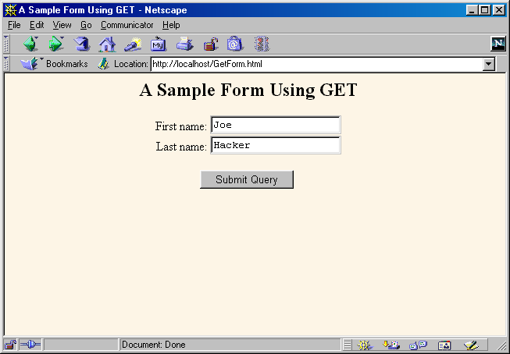
HTML Form: Initial Result

Slide 35
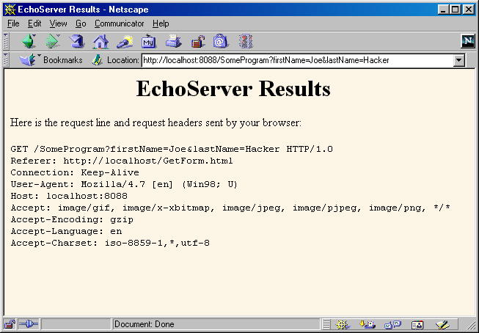
HTML Form: Submission Result
(Data Sent to EchoServer)

Slide 36
Sending POST Data
<!DOCTYPE HTML PUBLIC "-//W3C//DTD HTML 4.0 Transitional//EN">
<HTML>
<HEAD><TITLE>A Sample Form Using POST</TITLE></HEAD>
<BODY BGCOLOR="#FDF5E6">
<H2 ALIGN="CENTER">A Sample Form Using POST</H2>
<FORM ACTION="http://localhost:8088/SomeProgram"
METHOD="POST">
<CENTER>
First name:
<INPUT TYPE="TEXT" NAME="firstName" VALUE="Joe"><BR>
Last name:
<INPUT TYPE="TEXT" NAME="lastName" VALUE="Hacker"><P>
<INPUT TYPE="SUBMIT">
</CENTER>
</FORM>
</BODY></HTML>

Slide 37
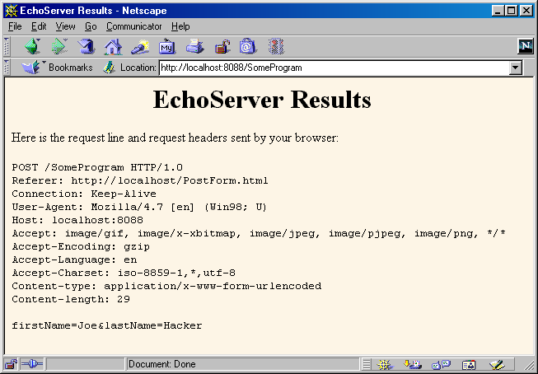
Sending POST Data

Slide 38
Reading Form Data In Servlets
request.getParameter("name")
  Returns URL-decoded value of first occurrence of name in query string
  Works identically for GET and POST requests
  Returns null if no such parameter is in query
request.getParameterValues("name")
  Returns an array of the URL-decoded values of all occurrences of name in query string
  Returns a one-element array if param not repeated
  Returns null if no such parameter is in query
request.getParameterNames()
  Returns Enumeration of request params

Slide 39
Handling Input in Multiple Languages
Use server's default character set
  String firstName =
  request.getParameter("firstName");
Convert from English (Latin-1) to Japanese
  String firstNameWrongEncoding =
  request.getParameter("firstName");
  String firstName =
  new String(firstNameWrongEncoding.getBytes(),
  "Shift_JIS");
Accept either English or Japanese
  request.setCharacterEncoding("JISAutoDetect");
  String firstName =
  request.getParameter("firstName");

Slide 40
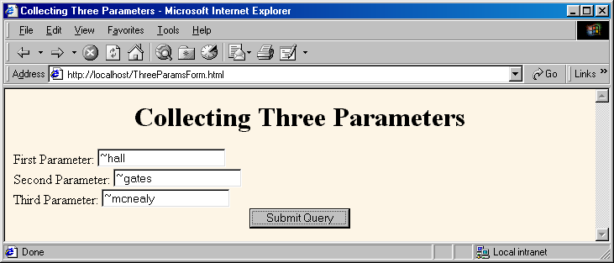
An HTML Form With Three Parameters
<FORM ACTION="/servlet/coreservlets.ThreeParams">
First Parameter: <INPUT TYPE="TEXT" NAME="param1"><BR>
Second Parameter: <INPUT TYPE="TEXT" NAME="param2"><BR>
Third Parameter: <INPUT TYPE="TEXT" NAME="param3"><BR>
<CENTER><INPUT TYPE="SUBMIT"></CENTER>
</FORM>

Slide 41
Reading the Three Parameters
public class ThreeParams extends HttpServlet {
public void doGet(HttpServletRequest request,
HttpServletResponse response)
throws ServletException, IOException {
response.setContentType("text/html");
PrintWriter out = response.getWriter();
String title = "Reading Three Request Parameters";
out.println(ServletUtilities.headWithTitle(title) +
"<BODY BGCOLOR=\"#FDF5E6\">\n" +
"<H1 ALIGN=CENTER>" + title + "</H1>\n" +
"<UL>\n" +
" <LI><B>param1</B>: "
+ request.getParameter("param1") + "\n" +
" <LI><B>param2</B>: "
+ request.getParameter("param2") + "\n" +
" <LI><B>param3</B>: "
+ request.getParameter("param3") + "\n" +
"</UL>\n" +
"</BODY></HTML>"); }}

Slide 42
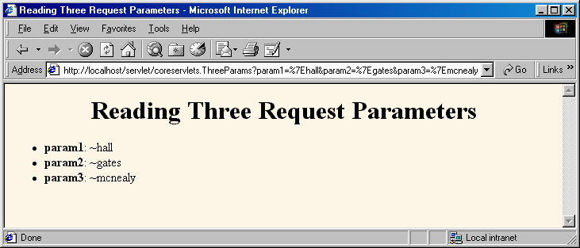
Reading Three Parameters:
Result

Slide 43
Reading All Parameters
public class ShowParameters extends HttpServlet {
public void doGet(HttpServletRequest request,
HttpServletResponse response)
throws ServletException, IOException {
response.setContentType("text/html");
PrintWriter out = response.getWriter();
String title = "Reading All Request Parameters";
out.println(ServletUtilities.headWithTitle(title) +
"<BODY BGCOLOR=\"#FDF5E6\">\n" +
"<H1 ALIGN=CENTER>" + title + "</H1>\n" +
"<TABLE BORDER=1 ALIGN=CENTER>\n" +
"<TR BGCOLOR=\"#FFAD00\">\n" +
"<TH>Parameter Name<TH>Parameter Value(s)");

Slide 44
Reading All Parameters (Continued)
Enumeration paramNames = request.getParameterNames();
while(paramNames.hasMoreElements()) {
String paramName = (String)paramNames.nextElement();
out.print("<TR><TD>" + paramName + "\n<TD>");
String[] paramValues =
request.getParameterValues(paramName);
if (paramValues.length == 1) {
String paramValue = paramValues[0];
if (paramValue.length() == 0)
out.println("<I>No Value</I>");
else
out.println(paramValue);

Slide 45
Reading All Parameters (Continued)
} else {
out.println("<UL>");
for(int i=0; i<paramValues.length; i++) {
out.println("<LI>" + paramValues[i]);
}
out.println("</UL>");
}
}
out.println("</TABLE>\n</BODY></HTML>");
}
public void doPost(HttpServletRequest request,
HttpServletResponse response)
throws ServletException, IOException {
doGet(request, response);
}
}

Slide 46
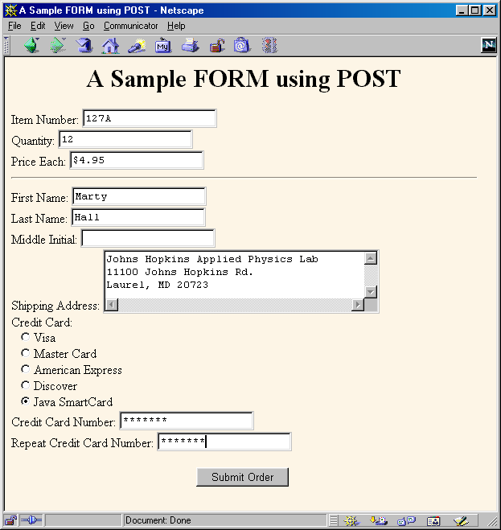
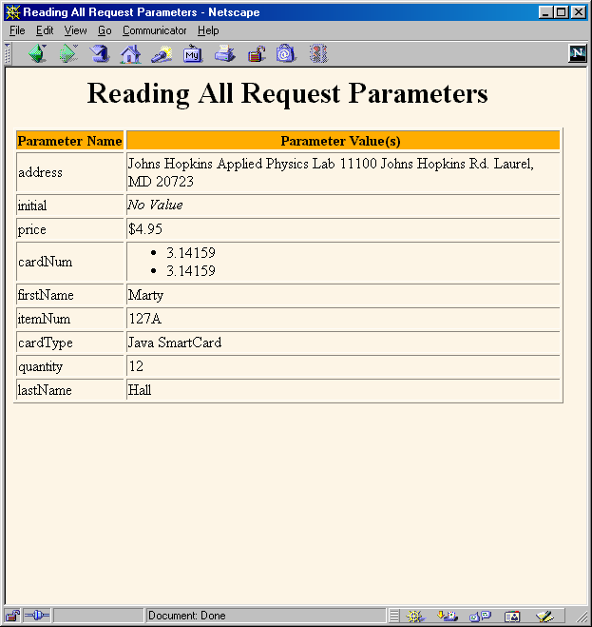
Result of ShowParameters Servlet
  Note that order of parameters in Enumeration does not match order they appeared in Web page

Slide 47
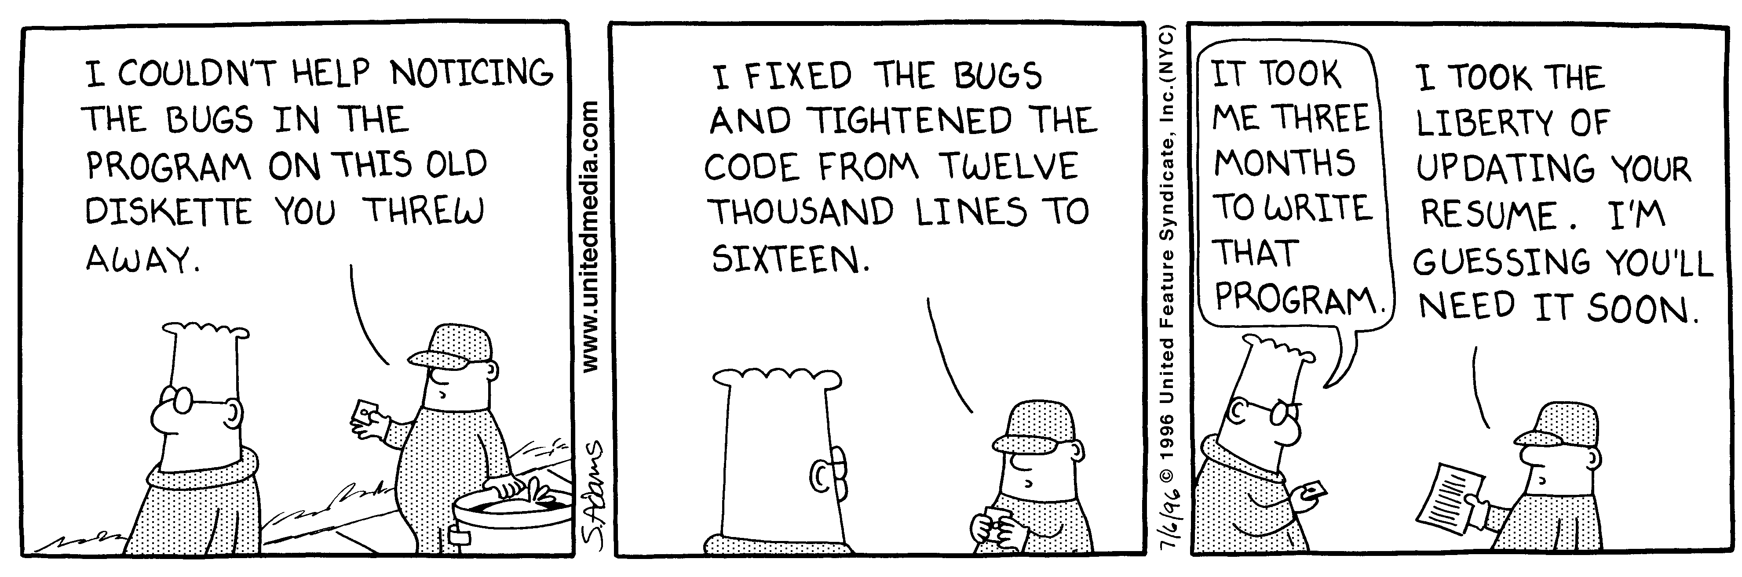
A Resumé Posting Service
Dilbert used with permission of United Syndicates Inc.

Slide 48
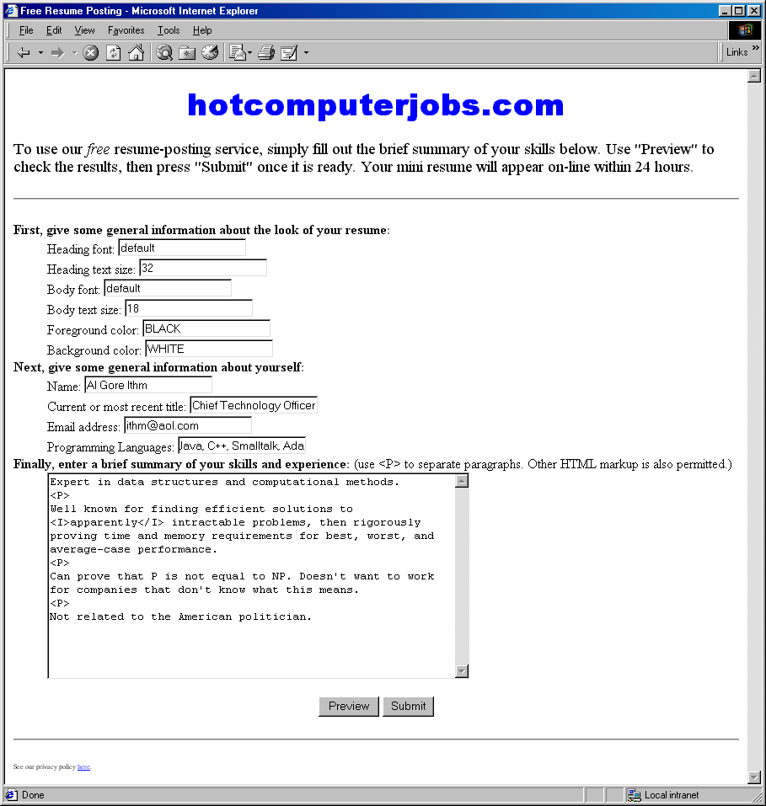
Posting Service: Front End
Gathers resumé
formatting and
content
information

Slide 49
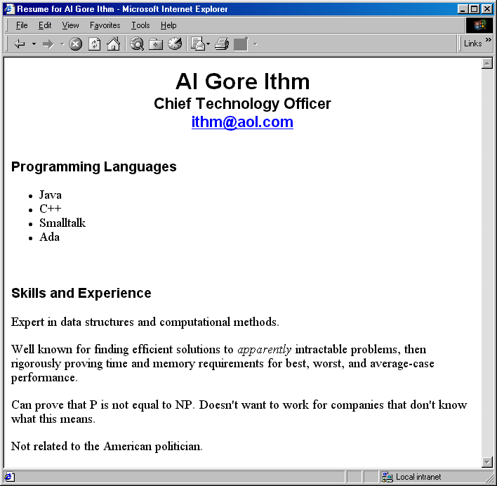
Posting Service: Back End
Previews
result
or stores
resumé
in database

Slide 50
Point: Check for Missing Data
Textfield was not in HTML form at all
  request.getParameter returns null
Textfield was empty when form was submitted
  Request.getParameter returns an empty String
Example Check
String value = request.getParameter("someName");
if ((value != null) && (!value.equals("")) {
…
}
Notes:
Only data in form will be sent to server in case of pressing submit button

Slide 51
Posting Service: Servlet Code
private void showPreview(HttpServletRequest request,
PrintWriter out) {
String headingFont = request.getParameter("headingFont");
headingFont = replaceIfMissingOrDefault(headingFont, "");
...
String name = request.getParameter("name");
name = replaceIfMissing(name, "Lou Zer");
String title = request.getParameter("title");
title = replaceIfMissing(title, "Loser");
String languages = request.getParameter("languages");
languages = replaceIfMissing(languages, "<I>None</I>");
String languageList = makeList(languages);
String skills = request.getParameter("skills");
skills = replaceIfMissing(skills, "Not many, obviously.");
...
}
Point: always explicitly handle
missing or malformed query data

Slide 52
Filtering Strings for HTML-Specific Characters
You cannot safely insert arbitrary strings into servlet output
  < and > can cause problems anywhere
  & and " can cause problems inside of HTML attributes
You sometimes cannot manually translate
  The string is derived from a program excerpt or another source where it is already in some standard format
  The string is derived from HTML form data
Failing to filter special characters from form data makes you vulnerable to cross-site scripting attack
  http://www.cert.org/advisories/CA-2000-02.html
  http://www.microsoft.com/technet/security/crssite.asp

Slide 53
Filtering Code (ServletUtilities.java)
public static String filter(String input) {
StringBuffer filtered = new StringBuffer(input.length());
char c;
for(int i=0; i<input.length(); i++) {
c = input.charAt(i);
if (c == '<') {
filtered.append("&lt;");
} else if (c == '>') {
filtered.append("&gt;");
} else if (c == '"') {
filtered.append("&quot;");
} else if (c == '&') {
filtered.append("&amp;");
} else {
filtered.append(c);
}
}
return(filtered.toString());
}

Slide 54
Servlet That Fails to Filter
public class BadCodeServlet extends HttpServlet {
private String codeFragment =
"if (a<b) {\n" +
" doThis();\n" +
"} else {\n" +
" doThat();\n" +
"}\n";
public String getCodeFragment() {
return(codeFragment);
}

Slide 55
Servlet That Fails to Filter (Continued)
public void doGet(HttpServletRequest request,
HttpServletResponse response)
throws ServletException, IOException {
response.setContentType("text/html");
PrintWriter out = response.getWriter();
String title = "The Java 'if' Statement";
out.println(ServletUtilities.headWithTitle(title) +
"<BODY>\n" +
"<H1>" + title + "</H1>\n" +
"<PRE>\n" +
getCodeFragment() +
"</PRE>\n" +
"Note that you <I>must</I> use curly braces\n" +
"when the 'if' or 'else' clauses contain\n" +
"more than one expression.\n" +
"</BODY></HTML>");
}

Slide 56
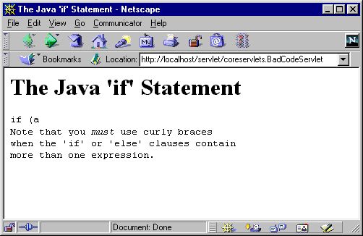
Servlet That Fails to Filter (Result)

Slide 57
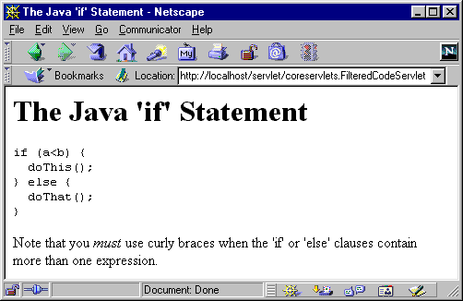
Servlet That Properly Filters
public class FilteredCodeServlet extends BadCodeServlet {
public String getCodeFragment() {
return(ServletUtilities.filter(super.getCodeFragment()));
}
}

Slide 58
Summary
Query data comes from HTML forms as URL-encoded name/value pairs
Servlets read data by calling request.getParameter("name")
  Results in value as entered into form, not as sent over network. I.e. not URL-encoded.
Always check for missing or
malformed data
  Missing: null or empty string
  Special case: query data that contains special HTML characters
    Need to be filtered if query data will be placed into resultant HTML page

Slide 59
Handling the Client Request: HTTP Request Headers

Slide 60
Agenda
Idea of HTTP request headers
Reading request headers
from servlets
Example: printing all headers
Common HTTP 1.1 request headers
Example: compressing Web pages
Example: password-protecting Web pages

Slide 61
Handling the Client Request: HTTP Request Headers
Example HTTP 1.1 Request
  GET /search?keywords=servlets+jsp HTTP/1.1
  Accept: image/gif, image/jpg, */*
  Accept-Encoding: gzip
  Connection: Keep-Alive
  Cookie: userID=id456578
  Host: www.somebookstore.com
  Referer: http://www.somebookstore.com/findbooks.html
  User-Agent: Mozilla/4.7 [en] (Win98; U)
It shouldn't take a rocket scientist to realize that you need to understand HTTP to be effective with servlets or JSP

Slide 62
Reading Request Headers (Methods in HttpServletRequest)
General
  getHeader
  getHeaders (2.2 only)
  getHeaderNames
Specialized
  getCookies
  getAuthType and getRemoteUser
  getContentLength
  getContentType
  getDateHeader
  getIntHeader
Related info
  getMethod, getRequestURI, getProtocol
Notes:
Uniform Resource Identifier

Slide 63
Checking For Missing Headers
HTTP 1.0
  All request headers are optional
HTTP 1.1
  Only Host is required
Conclusion
  Always check that request.getHeader is non-null before trying to use it
    String val = request.getHeader("some name");
    if (val != null) {
    …
    }

Slide 64
Printing All Headers
public class ShowRequestHeaders extends HttpServlet {
public void doGet(HttpServletRequest request,
HttpServletResponse response)
throws ServletException, IOException {
response.setContentType("text/html");
PrintWriter out = response.getWriter();
String title = "Servlet Example: Showing Request Headers";
out.println(ServletUtilities.headWithTitle(title) +
"<BODY BGCOLOR=\"#FDF5E6\">\n" +
"<H1 ALIGN=CENTER>" + title + "</H1>\n" +
"<B>Request Method: </B>" +
request.getMethod() + "<BR>\n" +
"<B>Request URI: </B>" +
request.getRequestURI() + "<BR>\n" +
"<B>Request Protocol: </B>" +
request.getProtocol() + "<BR><BR>\n" +

Slide 65
Printing All Headers (Continued)
"<TABLE BORDER=1 ALIGN=CENTER>\n" +
"<TR BGCOLOR=\"#FFAD00\">\n" +
"<TH>Header Name<TH>Header Value");
Enumeration headerNames = request.getHeaderNames();
while(headerNames.hasMoreElements()) {
String headerName = (String)headerNames.nextElement();
out.println("<TR><TD>" + headerName);
out.println(" <TD>" + request.getHeader(headerName));
}
out.println("</TABLE>\n</BODY></HTML>");
}
public void doPost(HttpServletRequest request,
HttpServletResponse response)
throws ServletException, IOException {
doGet(request, response);
}
}

Slide 66
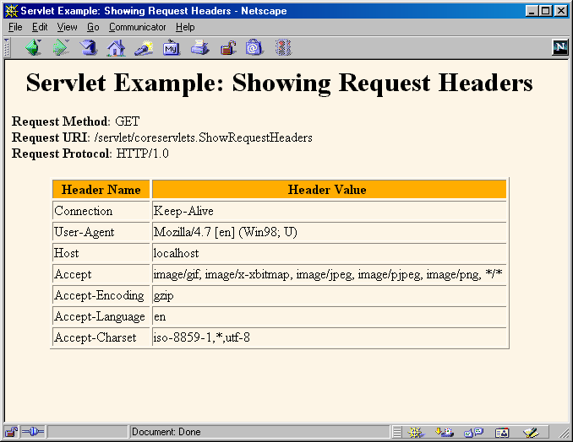
Printing All Headers:
Typical Netscape Result

Slide 67
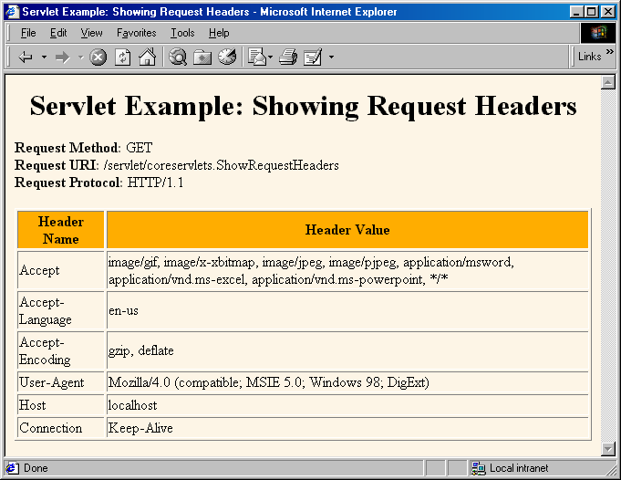
Printing All Headers:
Typical Internet Explorer Result

Slide 68
Common HTTP 1.1 Request Headers
Accept
  Indicates MIME types browser can handle
  Can send different content to different clients. For example, PNG files have good compression characteristics but are not widely supported in browsers. A servlet could check to see if PNG is supported, sending <IMG SRC="picture.png" ...> if it is supported, and <IMG SRC="picture.gif" ...> if not.
  Warning: IE incorrectly sets this header when you hit the Refresh button. It sets it correctly on original request.
Accept-Encoding
  Indicates encodings (e.g., gzip or compress) browser can handle.
  See following example

Slide 69
Common HTTP 1.1 Request Headers (Continued)
Authorization
  User identification for password-protected pages.
  See upcoming example.
  Instead of HTTP authorization, use HTML forms to send username/password and store info in session object. This approach is usually preferable because standard HTTP authorization results in a small, terse dialog box that is unfamiliar to many users.
  Servers have high-level way to set up password-protected pages without explicit programming in the servlets.
    For details, see Chapter 7 (Declarative Security) and Chapter 8 (Programmatic Security) of More Servlets and JavaServer Pages, www.moreservlets.com.

Slide 70
Common HTTP 1.1 Request Headers (Continued)
Connection
  In HTTP 1.0, keep-alive means browser can handle persistent connection. In HTTP 1.1, persistent connection is default. Persistent connections mean that the server can reuse the same socket over again for requests very close together from the same client (e.g., the images associated with a page, or cells within a framed page).
  Servlets can't do this unilaterally; the best they can do is to give the server enough info to permit persistent connections. So, they should set Content-Length with setContentLength (using ByteArrayOutputStream to determine length of output). See example in book.
Cookie
  Gives cookies previously sent to client. Use getCookies, not getHeader. See chapter & later class session.

Slide 71
Common HTTP 1.1 Request Headers (Continued)
Host
  Indicates host given in original URL
  This is a required header in HTTP 1.1. This fact is important to know if you write a custom HTTP client (e.g., WebClient used in CSAJSP Chapter 2) or telnet to a server and use the HTTP/1.1 version.
If-Modified-Since
  Indicates client wants page only if it has been changed after specified date
  Don’t handle this situation directly; implement getLastModified instead. See example in CSAJSP Chapter 2.

Slide 72
Common HTTP 1.1 Request Headers (Continued)
Referer
  URL of referring Web page
  Useful for tracking traffic; logged by many servers
  Can also be used to let users set preferences and then return to the page they came from
  Can be easily spoofed, so don't let this header be your sole means of deciding (for example) how much to pay sites that show your banner ads.
  Some personal firewalls, Norton in particular, screen this out and replace it with Weferer (and random chars as values)
User-Agent
  String identifying the browser making the request
  Best used for identifying category of client
    Web browser vs. I-mode cell phone, etc.
  For Web applications, use other headers if possible
  Again, can be easily spoofed.

Slide 73
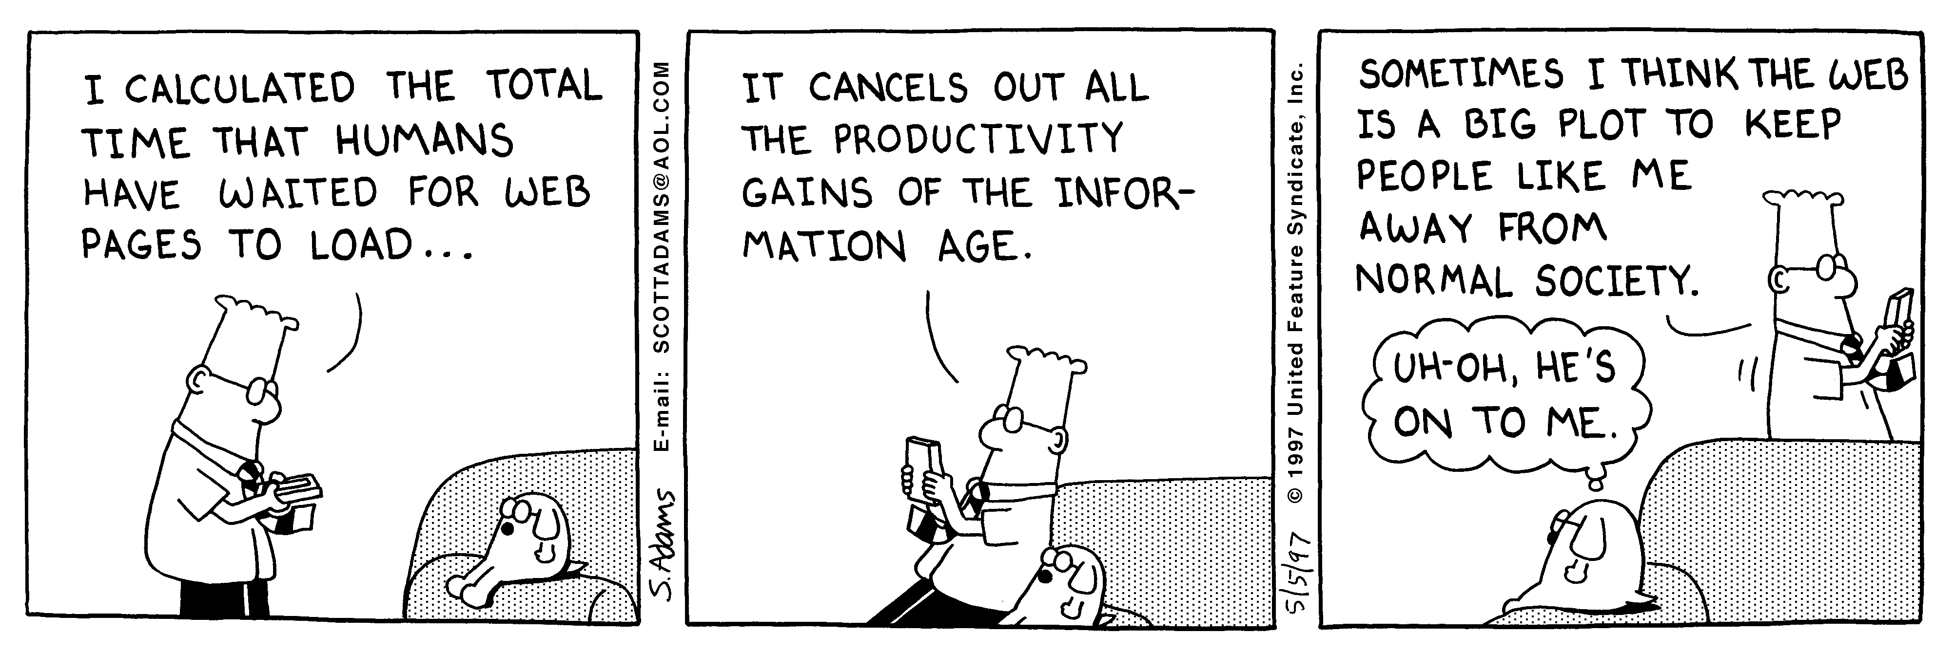
Sending Compressed
Web Pages
Dilbert used with permission of United Syndicates Inc.

Slide 74
Sending Compressed Pages:
EncodedPage.java
public void doGet(HttpServletRequest request,
HttpServletResponse response)
throws ServletException, IOException {
response.setContentType("text/html");
String encodings = request.getHeader("Accept-Encoding");
String encodeFlag = request.getParameter("encoding");
PrintWriter out;
String title;
if ((encodings != null) &&
(encodings.indexOf("gzip") != -1) &&
!"none".equals(encodeFlag)) {
title = "Page Encoded with GZip";
OutputStream out1 = response.getOutputStream();
out = new PrintWriter(new GZIPOutputStream(out1), false);
response.setHeader("Content-Encoding", "gzip");
} else {
title = "Unencoded Page";
out = response.getWriter();
}

Slide 75
Sending Compressed Pages:
EncodedPage.java (Continued)
out.println(ServletUtilities.headWithTitle(title) +
"<BODY BGCOLOR=\"#FDF5E6\">\n" +
"<H1 ALIGN=CENTER>" + title + "</H1>\n");
String line = "Blah, blah, blah, blah, blah. " +
"Yadda, yadda, yadda, yadda.";
for(int i=0; i<10000; i++) {
out.println(line);
}
out.println("</BODY></HTML>");
out.close();
}

Slide 76
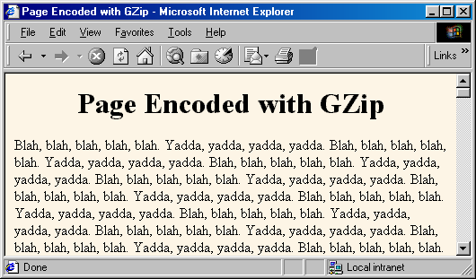
Sending Compressed Pages:
Results
Uncompressed (28.8K modem),
Netscape 4.7 and Internet Explorer 5.0:
> 50 seconds
Compressed (28.8K modem),
Netscape 4.7 and Internet Explorer 5.0:
< 5 seconds
Caution:
be careful
about
generalizing
benchmarks

Slide 77
Restricting Access to Web Pages
Main approach: "declarative" security via web.xml settings
  See More Servlets and JSP for lots of detail
Alternative: programmatic HTTP
  Check whether there is Authorization header. If not, go to Step 2. If so, skip over word “basic” and reverse the base64 encoding of the remaining part. This results in a string of the form username:password. Check the username and password against some stored set. If it matches, return the page. If not, go to Step 2.
  Return a 401 (Unauthorized) response code and a header of the following form:
  WWW-Authenticate: BASIC realm="some-name"
  This instructs browser to pop up a dialog box telling the user to enter a name and password for some-name, then to reconnect with that username and password embedded in a single base64 string inside the Authorization header.

Slide 78
SecretServlet (Registered Name of ProtectedPage Servlet)
public class ProtectedPage extends HttpServlet {
private Properties passwords;
private String passwordFile;
public void init(ServletConfig config)
throws ServletException {
super.init(config);
try {
passwordFile =
config.getInitParameter("passwordFile");
passwords = new Properties();
passwords.load(new FileInputStream(passwordFile));
} catch(IOException ioe) {}
}

Slide 79
SecretServlet (Continued)
public void doGet(HttpServletRequest request,
HttpServletResponse response)
throws ServletException, IOException {
response.setContentType("text/html");
PrintWriter out = response.getWriter();
String authorization =
request.getHeader("Authorization");
if (authorization == null) {
askForPassword(response);
} else {
String userInfo =
authorization.substring(6).trim();
BASE64Decoder decoder = new BASE64Decoder();
String nameAndPassword =
new String(decoder.decodeBuffer(userInfo));
// Check name and password

Slide 80
SecretServlet (Continued)
private void askForPassword
(HttpServletResponse response) {
// SC_UNAUTHORIZED is 401
response.setStatus(response.SC_UNAUTHORIZED);
response.setHeader("WWW-Authenticate",
"BASIC realm=\"privileged-few\"");
}

Slide 81
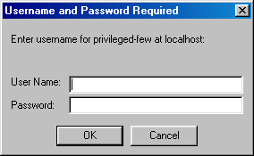
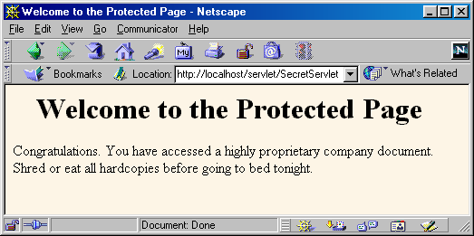
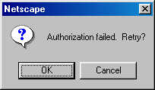
SecretServlet In Action

Slide 82
Summary
Many servlet tasks can only be accomplished by making use of HTTP headers coming from the browser
Use request.getHeader for arbitrary header
  Remember to check for null
Cookies, authorization info, content length, and content type have shortcut methods
Most important headers you read directly
  Accept
  Accept-Encoding
  Connection
  Referer
  User-Agent

Slide 83
Generating the
HTTP Response
Core Servlets & JSP book: www.coreservlets.com
More Servlets & JSP book: www.moreservlets.com
Servlet and JSP Training Courses: courses.coreservlets.com

Slide 84
Agenda
Idea of HTTP status codes
Setting status codes from servlets
Common HTTP 1.1 status codes
A common front end to various Web search engines
Idea of HTTP response headers
Setting response headers from servlets
Common HTTP 1.1 response headers
Persistent servlet state and auto-reloading pages

Slide 85
Generating the Server Response: HTTP Status Codes
Example HTTP 1.1 Response
  HTTP/1.1 200 OK
  Content-Type: text/html
  <!DOCTYPE ...>
  <HTML>
  ...
  </HTML>
Changing the status code lets you perform a number of tasks not otherwise possible
  Forward client to another page
  Indicate a missing resource
  Instruct browser to use cached copy
Set status before sending document

Slide 86
Setting Status Codes
response.setStatus(int statusCode)
  Use a constant for the code, not an explicit int.
  Constants are in HttpServletResponse
  Names derived from standard message.
  E.g., SC_OK, SC_NOT_FOUND, etc.
response.sendError(int code,
String message)
  Wraps message inside small HTML document
response.sendRedirect(String url)
  Relative URLs permitted in 2.2 and later
  Sets Location header also

Slide 87
Common HTTP 1.1 Status Codes
200 (OK)
  Everything is fine; document follows.
  Default for servlets.
204 (No Content)
  Browser should keep displaying previous document.
301 (Moved Permanently)
  Requested document permanently moved elsewhere (indicated in Location header).
  Browsers go to new location automatically.

Slide 88
Common HTTP 1.1 Status Codes (Continued)
302 (Found)
  Requested document temporarily moved elsewhere (indicated in Location header).
  Browsers go to new location automatically.
  Servlets should use sendRedirect, not setStatus, when setting this header. See example.
401 (Unauthorized)
  Browser tried to access password-protected page without proper Authorization header. See example in book.
404 (Not Found)
  No such page. Servlets should use sendError to set this.
  Problem: Internet Explorer 5.0.
  Fun and games: http://www.plinko.net/404/

Slide 89
A Front End to Various Search Engines: Code
public void doGet(HttpServletRequest request,
HttpServletResponse response)
throws ServletException, IOException {
String searchString =
request.getParameter("searchString");
if ((searchString == null) ||
(searchString.length() == 0)) {
reportProblem(response, "Missing search string.");
return;
}
searchString = URLEncoder.encode(searchString);
String numResults =
request.getParameter("numResults");
...
String searchEngine =
request.getParameter("searchEngine");

Slide 90
A Front End to Various Search Engines: Code (Continued)
SearchSpec[] commonSpecs =
SearchSpec.getCommonSpecs();
for(int i=0; i<commonSpecs.length; i++) {
SearchSpec searchSpec = commonSpecs[i];
if (searchSpec.getName().equals(searchEngine)) {
String url =
searchSpec.makeURL(searchString, numResults);
response.sendRedirect(url);
return;
}
}
reportProblem(response,
"Unrecognized search engine.");

Slide 91
A Front End to Various Search Engines: Code (Continued)
private void reportProblem(HttpServletResponse response,
String message)
throws IOException {
response.sendError(response.SC_NOT_FOUND,
message);
}

Slide 92
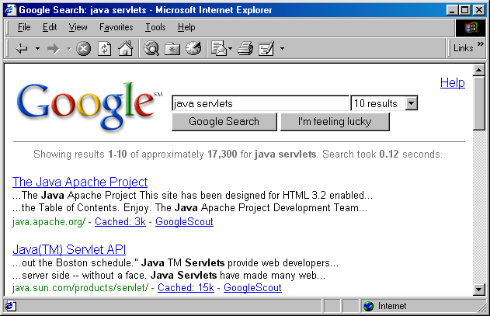
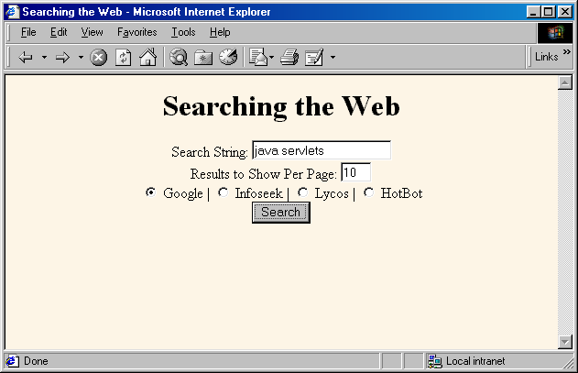
Front End to Search Engines: Result of Legal Request

Slide 93
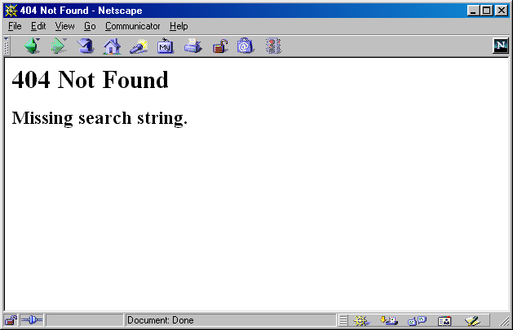
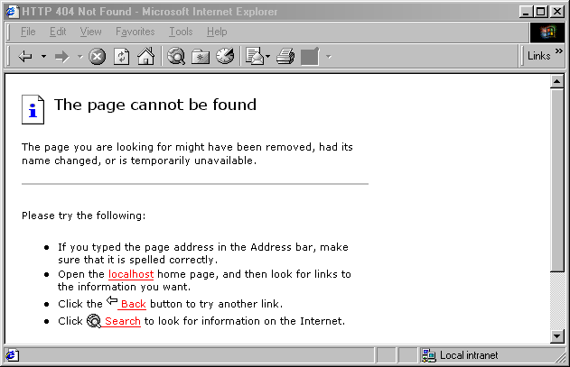
Front End to Search Engines: Result of Illegal Request
Fix:
Tools, Internet Options,
deselect "Show 'friendly' HTTP error messages"
Not a real fix -- doesn't help unsuspecting users of your pages

Slide 94
Generating the Server Response: HTTP Response Headers
Purposes
  Give forwarding location
  Specify cookies
  Supply the page modification date
  Instruct the browser to reload the page after a designated interval
  Give the document size so that persistent HTTP connections can be used
  Designate the type of document being generated
  Etc.

Slide 95
Setting Arbitrary Response Headers
public void setHeader(String headerName,
String headerValue)
  Sets an arbitrary header.
public void setDateHeader(String name,
long millisecs)
  Converts milliseconds since 1970 to a date string in GMT format.
public void setIntHeader(String name,
int headerValue)
  Prevents need to convert int to String before calling setHeader.
addHeader, addDateHeader, addIntHeader
  Adds new occurrence of header instead of replacing.
  Servlets 2.2/2.3 only.

Slide 96
Setting Common Response Headers
setContentType
  Sets the Content-Type header.
  Servlets almost always use this.
  See table of common MIME types.
setContentLength
  Sets the Content-Length header.
  Used for persistent HTTP connections.
  See Connection request header.
addCookie
  Adds a value to the Set-Cookie header.
  See separate section on cookies.
sendRedirect
  Sets the Location header (plus changes status code).

Slide 97
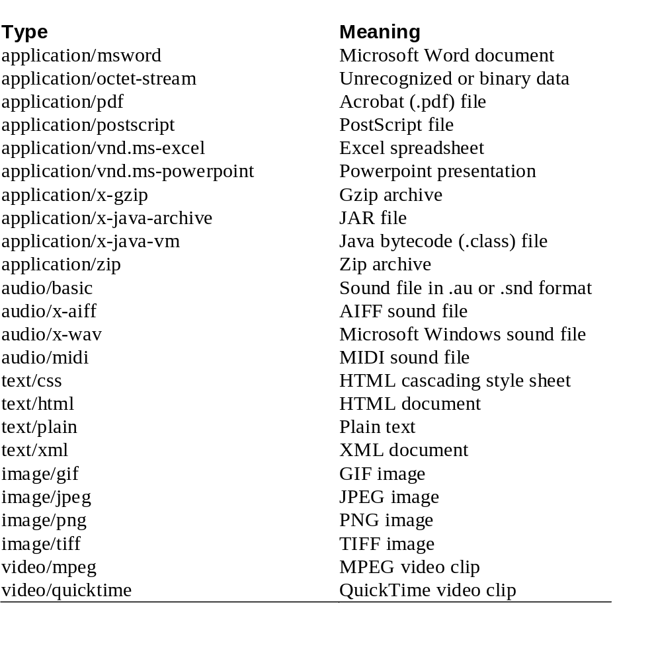
Common MIME Types
Notes:
MIME: Multipurpose Internet Mail Extensions

Slide 98
Common HTTP 1.1 Response Headers
Cache-Control (1.1) and Pragma (1.0)
  A no-cache value prevents browsers from caching page. Send both headers or check HTTP version.
Content-Encoding
  The way document is encoded. Browser reverses this encoding before handling document. See compression example earlier.
Content-Length
  The number of bytes in the response.
  See setContentLength on previous slide.
  Use ByteArrayOutputStream to buffer document before sending it, so that you can determine size. See discussion of the Connection request header and detailed example in book.

Slide 99
Common HTTP 1.1 Response Headers (Continued)
Content-Type
  The MIME type of the document being returned.
  Use setContentType to set this header.
Expires
  The time at which document should be considered out-of-date and thus should no longer be cached.
  Use setDateHeader to set this header.
Last-Modified
  The time document was last changed.
  Don’t set this header explicitly; provide a getLastModified method instead.
  See example in CSAJSP Chapter 2.

Slide 100
Common HTTP 1.1 Response Headers (Continued)
Location
  The URL to which browser should reconnect.
  Use sendRedirect instead of setting this directly.
Refresh
  The number of seconds until browser should reload page. Can also include URL to connect to.
  See following example.
Set-Cookie
  The cookies that browser should remember. Don’t set this header directly; use addCookie instead. See next section.
WWW-Authenticate
  The authorization type and realm needed in Authorization header. See example in CSAJSP Section 4.5.

Slide 101
Persistent Servlet State and Auto-Reloading Pages
Idea: generate list of large (e.g., 150-digit) prime numbers
  Show partial results until completed
  Let new clients make use of results from others
Demonstrates use of the Refresh header.
Shows how easy it is for servlets to maintain state between requests.
  Very difficult in traditional CGI.
Also illustrates that servlets can handle multiple simultaneous connections
  Each request is in a separate thread.

Slide 102
Generating Prime Numbers: Source Code
public void doGet(HttpServletRequest request,
HttpServletResponse response)
throws ServletException, IOException {
int numPrimes =
ServletUtilities.getIntParameter(request,
"numPrimes", 50);
int numDigits =
ServletUtilities.getIntParameter(request,
"numDigits", 120);
// findPrimeList is synchronized
PrimeList primeList =
findPrimeList(primeListVector, numPrimes, numDigits);
if (primeList == null) {
primeList = new PrimeList(numPrimes, numDigits, true);

Slide 103
Generating Prime Numbers: Source Code (Continued)
synchronized(primeListVector) {
if (primeListVector.size() >= maxPrimeLists)
primeListVector.removeElementAt(0);
primeListVector.addElement(primeList);
}
}
Vector currentPrimes = primeList.getPrimes();
int numCurrentPrimes = currentPrimes.size();
int numPrimesRemaining = (numPrimes - numCurrentPrimes);
boolean isLastResult = (numPrimesRemaining == 0);
if (!isLastResult) {
response.setHeader("Refresh", "5");
}
response.setContentType("text/html");
PrintWriter out = response.getWriter();
// Show List of Primes found ...

Slide 104
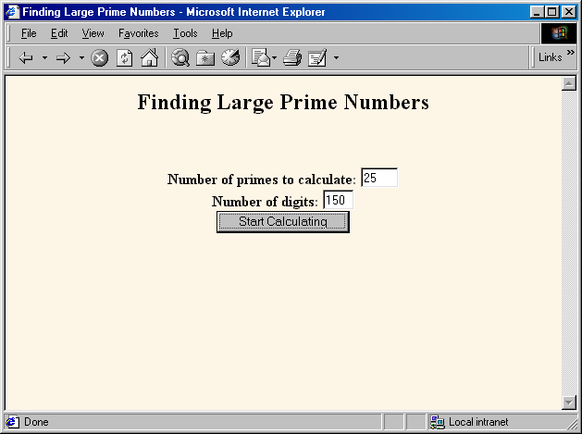
Prime Number Servlet:
Front End

Slide 105
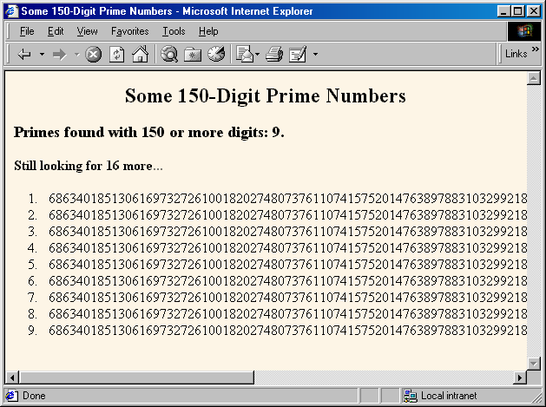
Prime Number Servlet:
Initial Result

Slide 106
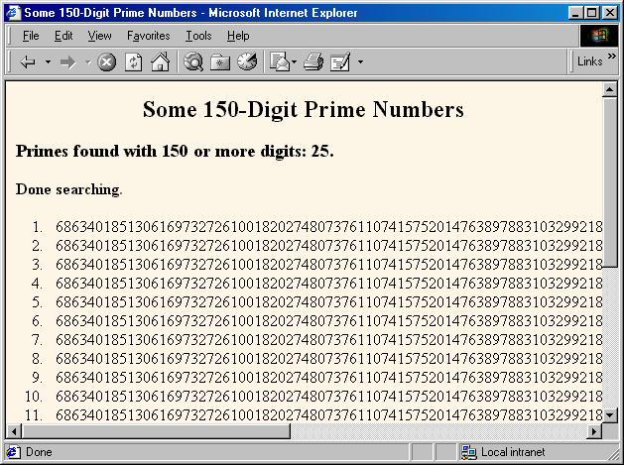
Prime Number Servlet:
Final Result

Slide 107
Summary
Many servlet tasks can only be accomplished through use of HTTP status codes and headers sent to the browser
Two parts of the response
  Status line
    In general, set via response.setStatus
    In special cases, set via
    response.sendRedirect and response.sendError
  Response headers
    In general, set via response.setHeader
    In special cases, set via response.setContentType, response.setContentLength, response.addCookie, and response.sendRedirect

Slide 108
Summary (Continued)
Most important status codes
  200 (default)
  302 (forwarding; set via sendRedirect)
  401 (password needed)
  404 (not found; set via sendError)
Most important headers you set directly
  Cache-Control and Pragma
  Content-Encoding
  Content-Length
  Expires
  Refresh
  WWW-Authenticate

